Slide 1
2023 Camp Coordination Meeting

Slide 2
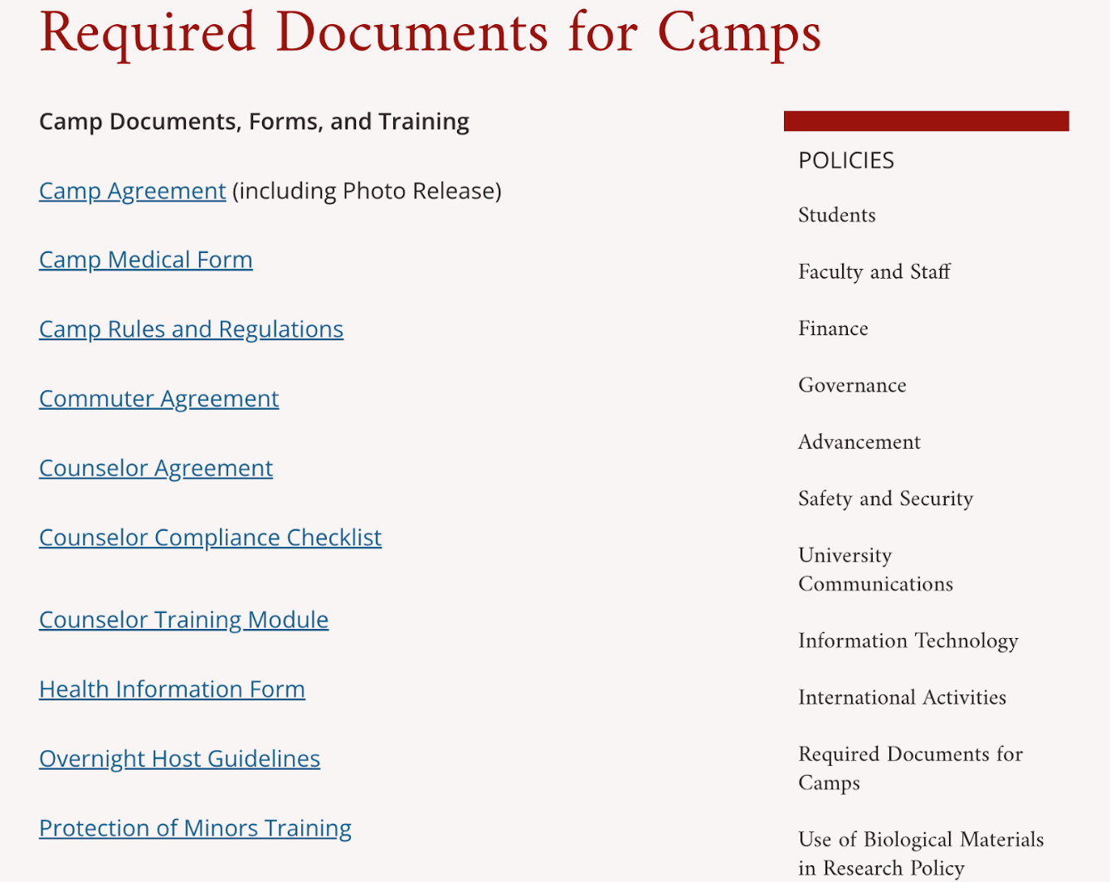
Objectives
Improve Coordination
Enhance Communication
100% Compliance with Risk and Legal Requirements
Improved Outreach = Increased Enrollment

Slide 3
Requirements – Camp Coordinators
Complete Google Form
Build Camp Forms from OGC Shell Forms
Complete Camp Checklist and Certification
Have Counselors complete training on Protection of Minors
Have Counselors file an updated Background Check
Have Coordinator sign certification checklist when all complete and upload to google share drive.
EHS / OGC available throughout process and will audit share drive on March 1 / April 1 / and 1 week prior to camp.

Slide 4
Required Forms from Campers
Camp Agreement and Photo Release - Sign and Complete
Health Information Form – Sign and Complete
Acknowledgement of Camp Rules
Authorization and Release for Self-Carry and Self-Administration of Medication (Physician and Participant)
Camper Commuter Agreement - Sign and Complete
Summer Housing Rules - Sign and Complete

Slide 5
Required from Counselors
Counselors Agreement – Acknowledgment
Standards of Conduct for Interacting with Minors
Summer Housing Rules - Sign and Complete
HR requirements for employment
Complete Protection of Minor Training
Background Check complete and up to date

Slide 6
Background Checks
Background check procedure
Background checks will be conducted for each summer camp program.
Departments should notify HR of individuals that need a background check at least ten days before camp starts.
HR will back charge Sponsoring departments background check fees when summer camp programs have minors.
The background checks will be done electronically through Truescreen.
HR needs the following information: legal name, email address and phone number.
HR will notify departments when individuals have passed their background checks. HR will notify the department directly if any individual(s) does not pass the background check.

Slide 7
I-9 Process
For those students who have never worked at the University and will be paid must complete an I-9 form.
I-9 Forms are Federal compliance forms.
Students will be asked to complete Section One of their I-9 form through Truescreen.
All authorized documents must verified physically in person in HR and will be photocopied. No exemptions will be made.
Students have up to three business days to provide authorized documents or they will be suspended from working. No pay will be provided.

Slide 8
Summer Hire and Employment
For paid student hires:
Fill out the google form - Student Employee Data Form (sEDF)
Need to be paid an hourly rate
Reach out to the business operations team at hr-businessoperations@cua.edu with any questions
Non-student hires:
Work with HR’s talent team to hire non-students who will be labeled hourly, temporary employees
Email them at hr-talent@cua.edu
Students must at least be paid Federal minimum wage $7.25 hourly
Currently, internal discussion on raising the wage rate

Slide 9
Overnight camps / Overtime
If the position is offered to non-students and the position is primarily a teaching position and recognized as such, then they may be exempt from overtime pay and minimum wage. Please check with OGC first as this is a narrow exception for camps
If a counselor is not primarily teaching (has significant administrative tasks), then we must pay minimum wage and count overtime.
For overnight camps, in your offer letters we must add this provision:
We will assign you to be on duty for 24 hours or more, but we agree to exclude a regularly scheduled and uninterrupted sleeping period of not more than 8 hours per every 24 hour period and these 8 hours are unpaid. If sleep is interrupted, please record hours worked.

Slide 10
Participant Registration & Housing

Slide 11
Events and Conference Services

Slide 12
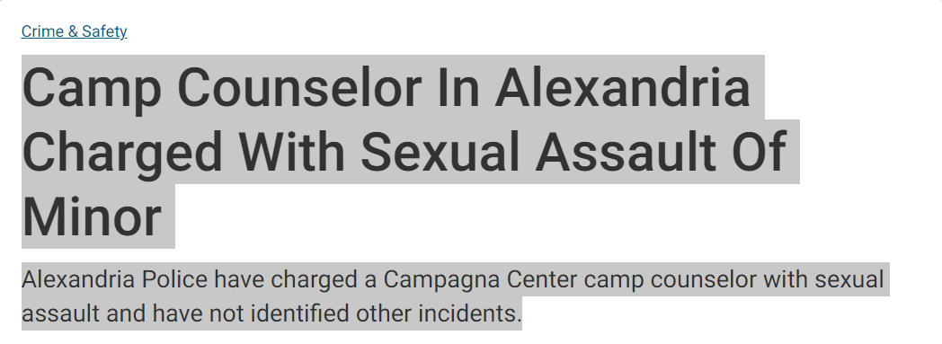
Protection of Minor Training
Four modules for training
Completion will be reported automatically through UE portal
Critical tool to prevent abuse of minors
layered approach
Excellent refresher for
Signs of Abuse
Boundaries - red flags
Financial Incentive to University for Camp Counselor Completions
100 % Compliance - no employee or volunteer will be permitted to work camp w/o training and updated background check

Slide 13
Prior to Day 1 of Camp
All Background Checks complete
All required documents, policies, and waivers uploaded into share drive
Checklist completed and signed
Attend EHS Spring Counselor Safety Brief (Date TBD)

