Slide 1
Safety Procedures
Summer Counselors

Slide 2
Emergency Preparedness
Evacuate
or
Shelter in Place

Slide 3
Accounting for missing people in an evacuation
Do you need to account for anyone?
Who needs to account for you?
Notes:
When an evacuation alarm goes off, look at who is in the room with you. Are they still there when you have assembled outside the building?

Slide 4
Assembly Areas
Notes:
Once you evacuate, stay in your appointed assembly area! Assembly areas are posted in the hallways in each building. If you leave the assembly area before you’re accounted for and dismissed, a firefighter may be sent into a burning building for no reason.

Slide 5
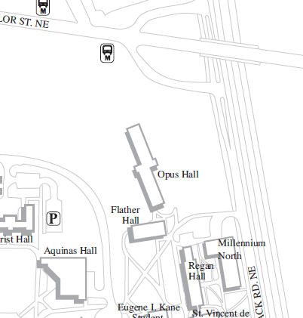
Notes:
If you’re in Opus Hall and a fire alarm goes off, where is your assembly area?

Slide 6
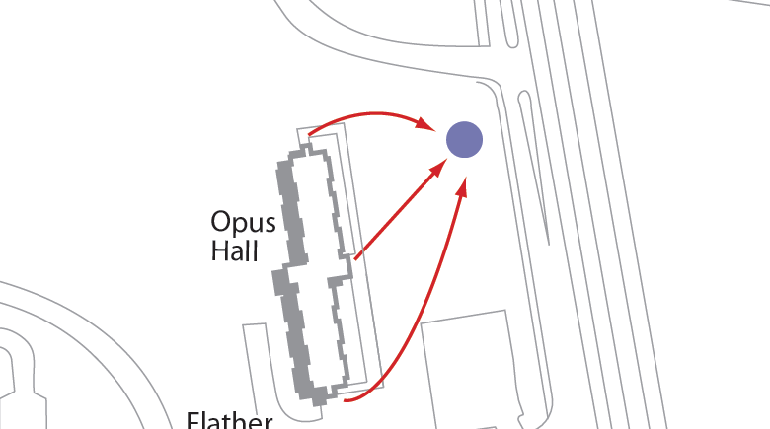

Slide 7
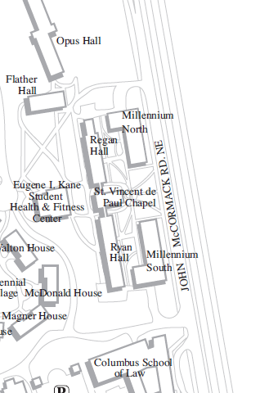
Notes:
Assembly areas for Regan, Ryan, and the Mills?

Slide 8
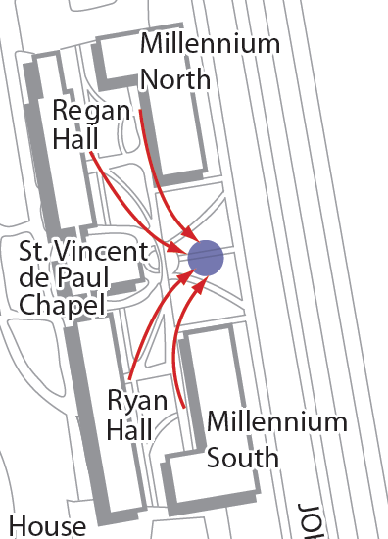

Slide 9
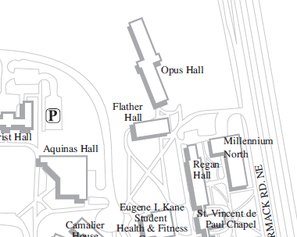
Notes:
Flather?

Slide 10
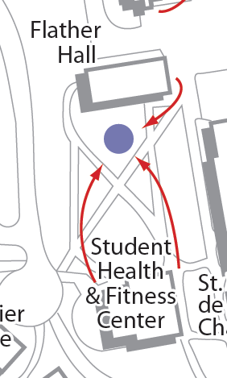

Slide 11
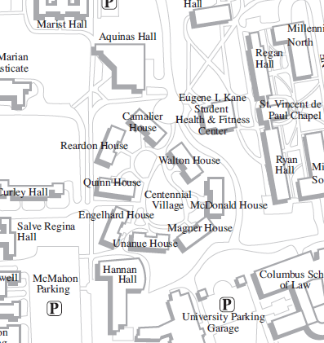
Notes:
Centennial Village?

Slide 12
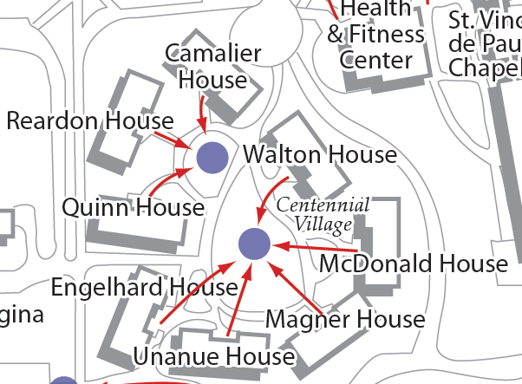

Slide 13
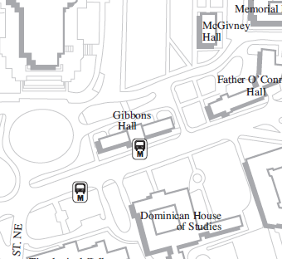
Notes:
Gibbons?

Slide 14
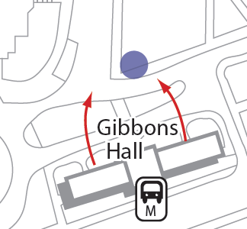

Slide 15
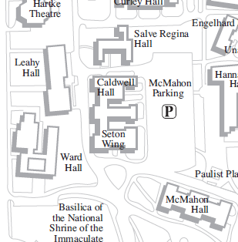
Notes:
Caldwell?

Slide 16
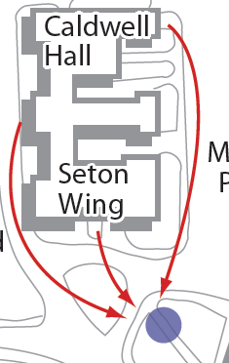

Slide 17
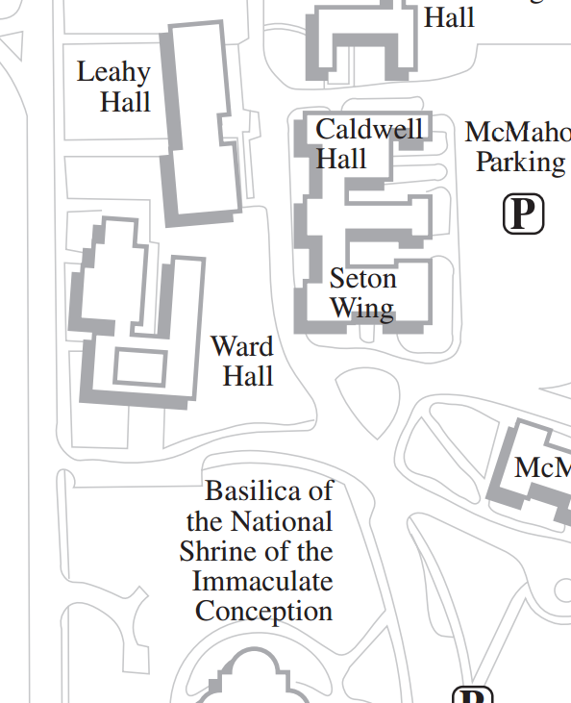
Notes:
Ward?

Slide 18
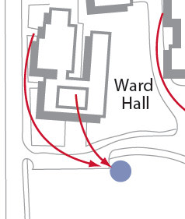

Slide 19
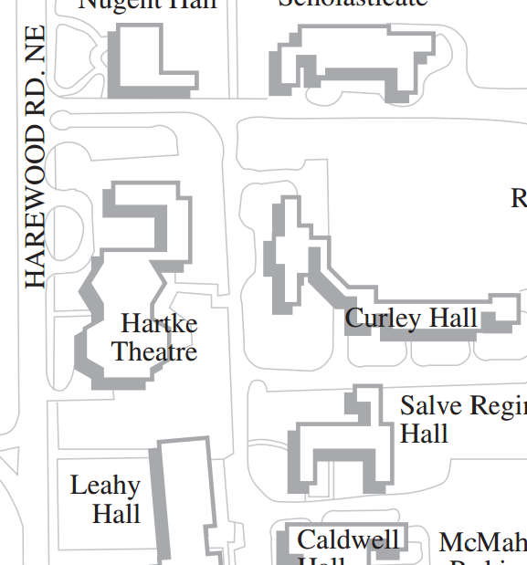
Notes:
Hartke?

Slide 21
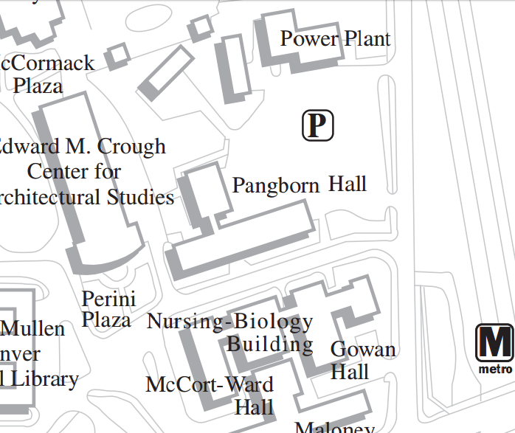
Notes:
Pangborn?

Slide 22
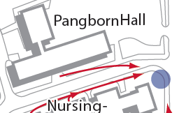

Slide 23
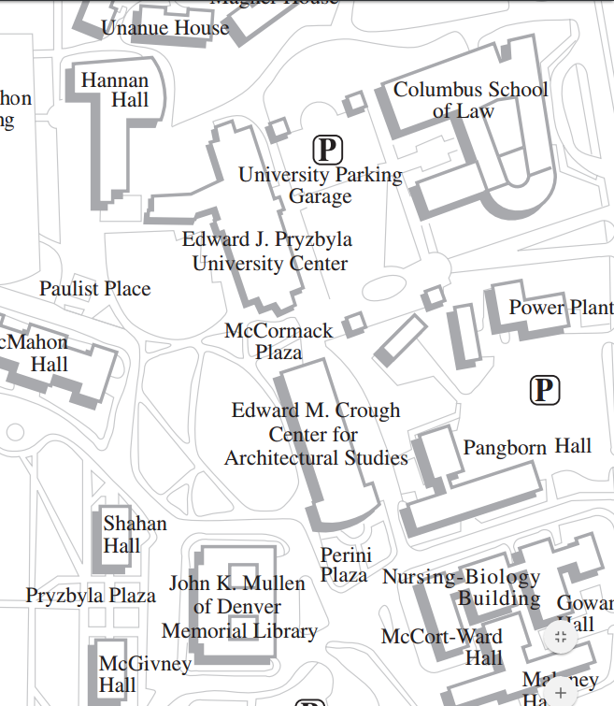
Notes:
Crough? Pryz?

Slide 24
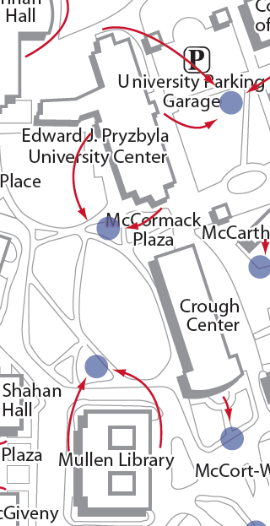

Slide 25
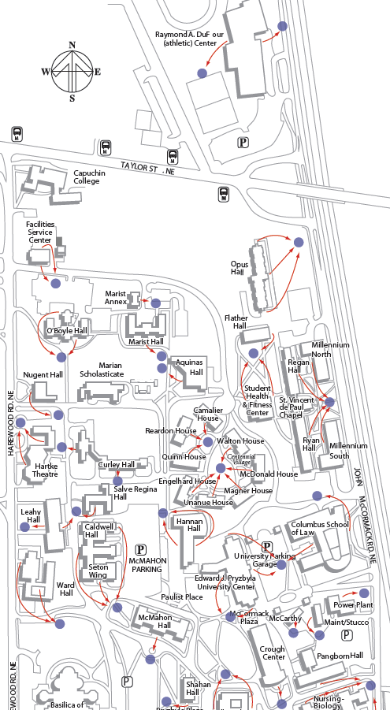
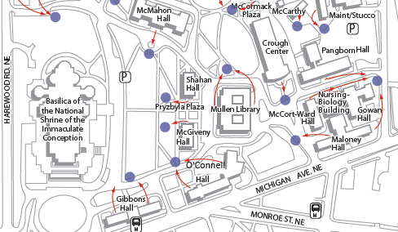

Slide 26
Shelter in Place Events
Chemical, Biological, Or Radiological Contaminants
Severe Weather
Active Shooter Or Armed Suspect
Notes:
This is not an all inclusive list of Shelter in Place events, just some common ones.

Slide 27
Chemical, Biological, Or Radiological Contaminants
Best place to go?

Slide 28
Chemical, Biological, Or Radiological Contaminants
http://www.nationalterroralert.com/shelterinplace/
Go to an interior room without windows that’s above ground level.
Close all windows and exterior doors.
If there is danger of explosion, close the window shades, blinds, or curtains.
Turn off all fans, heating and air conditioning systems.
Notes:
Trick question! All chemicals are different and it depends on the situation. In many cases, however, an above-ground location is preferable because often chemicals, etc. are heavier than air, and may seep into basements even if the windows are closed.

Slide 29
Severe Weather
Best place to go?

Slide 30
Severe Weather
Tornado Example
https://www.osha.gov/dts/weather/tornado/preparedness.html
Seek a small interior room or hallway on the lowest floor possible
Stay away from doors, windows, and outside walls
Stay in the center of the room, and avoid corners because they attract debris
Rooms constructed with reinforced concrete, brick or block with no windows and a heavy concrete floor or roof system overhead
Avoid auditoriums, cafeterias and gymnasiums that have flat, wide-span roofs.
Notes:
Again, this depends on the type of weather. Let’s look at tornadoes.

Slide 31
Active Shooter Or Armed Suspect
Best place to go?

Slide 32
Active Shooter Or Armed Suspect
https://www.dhs.gov/xlibrary/assets/active_shooter_booklet.pdf
If you are in an office or classroom, stay there and secure the door
If you are in a hallway, get into a room and secure the door
Avoid windows and other highly visible locations

Slide 33
Injuries and Illnesses
When treatment beyond first aid is needed

Slide 34
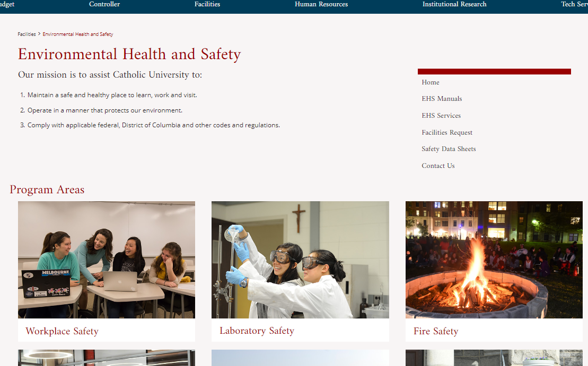
Illness/Injury treatment beyond first aid required
First report of injury for employees
Incident report for non-employees
ehs.cua.edu
“Workplace Safety”
Notes:
These reports are time-sensitive – complete them asap!

Slide 35
Pre-employment screening
Contact Andrea Daniels
Notes:
Those working directly with minors must have a completed background check via HR. These must be redone every three years.

Slide 36
“Protecting children from sexual misconduct” training
Must be completed prior to the start of camp
https://learn.ue.org/VE5CA791996/CUAProtectingChildren#Register
Notes:
Those working directly with minors must have completed this training. This must be redone annually.

Slide 37
Key take-away understandings:
Identify warning signs
Remember who to report misconduct within your department and the reporting requirements
Contact the Department of Public Safety for any emergency situation at 202-319-5111
Notes:
You are a mandatory reporter - don’t make promises you cannot keep.

Slide 38
Who to report to?
Supervisor
Frank Vinik
Title IX Coordinator Leahy 170, Human Resources tel. 202-319-4177
titleix-coord@cua.edu
DPS ext. 5111

Slide 39
Medical Care
Student Health Center is NOT available to camps.
Health forms must be immediately available to camp staff to give to emergency responders at any time, but not accessible to others.
Call Public Safety for an ambulance, x5111.

Slide 40
Urgent Care Centers in the D.C. Metropolitan Area
DC Immediate and Primary Care
Cleveland Park
2902 Porter Street NW
Washington DC 20008
202-525-5287
Hours: M-F 8am-8pm
Sat/Sun 8am-6pm
Farragut Medical and Travel Care
815 Connecticut Avenue, NW
Washington, DC 20006
202-775-8500
Hours: Monday-Friday 10am-5pm
* walk ins until 4pm only

Slide 41
Urgent Care Centers in the D.C. Metropolitan Area
Medstar PromptCare
Adams Morgan
1805 Columbia Road, NW
Washington DC 20009
202-797-4960
M-F 9am-8pm
Sat/Sun/holidays 9am-8pm
Medstarhealthcare.prg
*online check-in available
Mid Atlantic Urgent Care Center
3301 Wilson Boulevard
Arlingtpn VA 22201
703-243-6720
*near Virginia Square Metro
M-F 9am-7:30pm
Saturday 9am-5:30pm
Sunday 10am-4:30pm

Slide 42
Urgent Care Centers in the D.C. Metropolitan Area
Minute Clinic at CVS
for the hours and location of the nearest Minute Clinic please see their web site at:
http://minuteclinic.com/en/USA/Clinics.aspx
Medics USA
Columbia Heights
2750 14th St. NW
Washington, DC 20009
202-595-8813
Hours: M-F 9am-6pm
Minute Clinic at CVS
for the hours and location of the nearest Minute Clinic please see their web site at:
http://minuteclinic.com/en/USA/Clinics.aspx

Slide 43
Camper Medications
DO NOT carry or administer medication for campers
DO say something if you see:
Medication is being shared or distributed.
Campers have brought noticeably more medication than would be needed for the duration of the camp.
Medications (prescription or OTC) are not in their original container, labeled with the Camper’s name, name of the medication, dosage, frequency of administration, and prescribing physician’s name and phone number.
Campers have medication at camp without having completed the “Authorization for Self-Carry and Self-Administration of Medication” form.

Slide 44
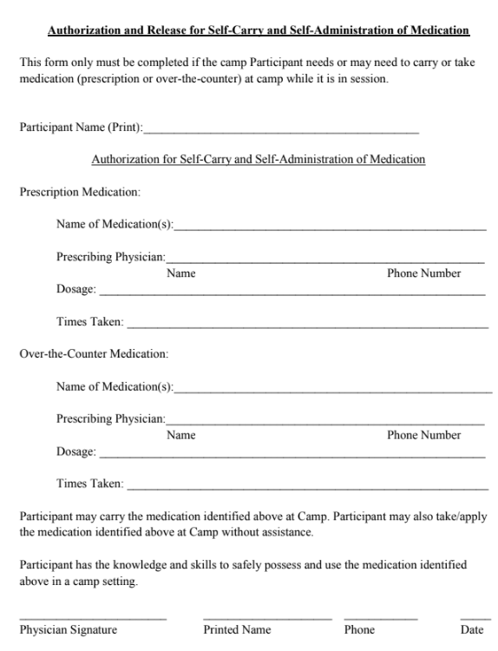
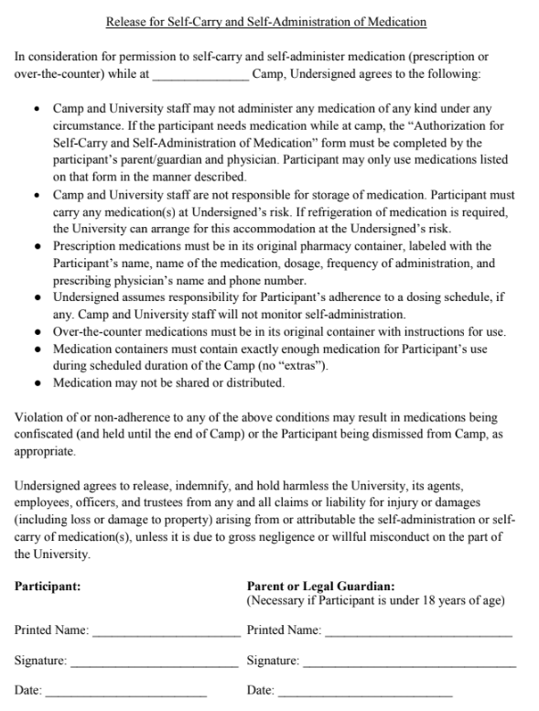

Slide 45
Summary
1. Emergency Preparedness
Evacuation Routes
Shelter in Place Best Practices
HazMat Situations
Severe Weather
Active Shooter/Suspect
Injury reporting
Employees
Non-employees
2. Pre-employment Screening
3. Protecting Minors from Sexual Misconduct Training
4. Medical Care
5. Camper Medications

Slide 46
Questions?
walters@cua.edu
202-319-5865

