Slide 1
Safety Procedures
Summer Counselors

Slide 2
Emergency Preparedness
Evacuate
or
Shelter in Place
Notes:
Evacuation: For an emergency that would be dangerous to your life and health if you were to stay in your building. Such as a fire or smoke in the building.
Shelter in place: For an emergency that would put you in danger if you were to leave your building. Such as a severe weather alert (tornado).

Slide 3
Agenda
Emergency Preparedness
Emergency Response-DPS
Evacuation Emergency
Shelter-in-Place Emergency
Injury Illness Reporting
Employees
Non-Employees
Pre-employment Screening
Protecting Minors from Sexual Misconduct Training
Medical Care
Camper Medications

Slide 4
Emergency Response- Department of Public Safety
Emergencies are communicated or reported to the Department of Public Safety at 202-319-5111. In an emergency situation where the campus requires an immediate response, the Catholic University Emergency Notification Plan will be activated.
DPS will:
Deploy the "All-Campus Alert" announcement system on campus with a set announcement.
Activate the CUAlert via Rave Mobile Safety.
Alert the Division of University Communications.
Notes:
(User preferences for CUAlert can be verified or updated at any time at CUAlert.cua.edu. Use your Catholic University username and password to log in.)

Slide 5
Emergency Response
Evacuation Emergency
Be prepared: Before an emergency happens, find at least two emergency exits from your building.
Sound the fire alarm in event of fire. For other evacuation emergencies, call the Department of Public Safety at x5111.
Exit the building from the closest available exit. Keep in mind an alternate route. Don't use the elevator.
If you can't evacuate: 1. Call x 5111 and/or go to a window and signal for help 2. Go to the nearest exit or preferred area of safe refuge and await the arrival of emergency personnel.
Notes:
This is not an all inclusive list of Shelter in Place events, just some common ones.

Slide 6
Emergency Response
Shelter-in-Place Emergency
Stay calm and do not panic.
Stay inside unless a fire alarm sounds or you have been instructed to leave by a CUA official.
For news bulletins, monitor this CUA Web page, e-mail and voice mail, and turn on the radio or TV.
If you are outside, seek shelter inside a building - do not remain outside.
Follow building-specific instructions from your Resident Assistant or the building Watch Captain.
Wait for further instructions from a CUA official.

Slide 7
Accounting for missing people in an evacuation
Do you need to account for anyone?
Who needs to account for you?
Notes:
When an evacuation alarm goes off, look at who is in the room with you. Are they still there when you have assembled outside the building?

Slide 8
Assembly Areas
Notes:
Once you evacuate, stay in your appointed assembly area! Assembly areas are posted in the hallways in each building. If you leave the assembly area before you’re accounted for and dismissed, a firefighter may be sent into a burning building for no reason.

Slide 9
Injuries and Illnesses
When treatment beyond first aid is needed

Slide 10
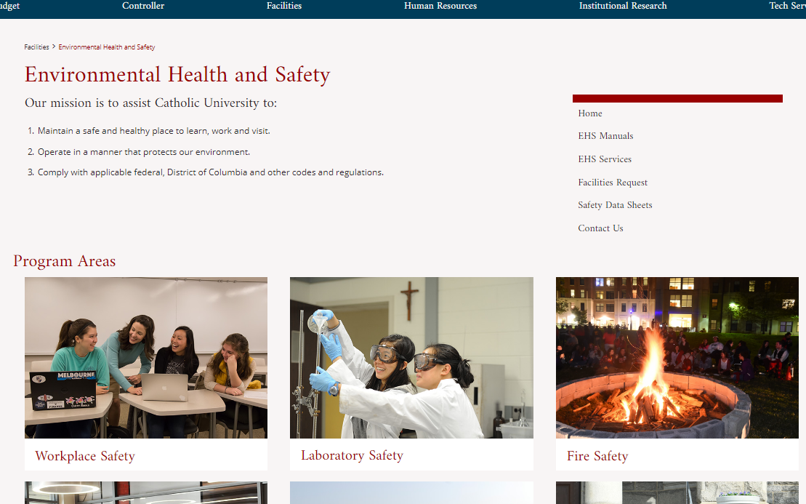
Illness/Injury treatment beyond first aid required
First report of injury for employees
Incident report for non-employees
facilities.catholic.edu/ehs/
“Workplace Safety”
Notes:
These reports are time-sensitive – complete them asap!

Slide 11
Pre-employment screening
Contact Andrea Daniels
Notes:
Those working directly with minors must have a completed background check completed via HR.

Slide 12
“Protecting children from sexual misconduct” training
Must be completed prior to the start of camp.
https://learn.ue.org/VE5CA791996/CUAProtectingChildren
Notes:
Those working directly with minors must have completed this training. This must be redone annually.

Slide 13
Key Takeaways:
Identify warning signs.
Remember who to report misconduct within your department and the reporting requirements.
Contact the Department of Public Safety for any emergency situation at 202-319-5111.
Notes:
You are a mandatory reporter - don’t make promises you cannot keep.

Slide 14
Who to report to?
Supervisor
Lou Mejia
Director of Compliance Leahy 200 tel. 202-319-6104
mejial@cua.edu
DPS ext. 5111

Slide 15
Medical Care
Student Health Center is NOT available to camps.
Health forms must be immediately available to camp staff to give to emergency responders at any time, but not accessible to others.
Call Public Safety for an ambulance, x5111.

Slide 16
Camper Medications
DO NOT carry or administer medication for campers
DO say something if you see:
Medication is being shared or distributed.
Campers have brought noticeably more medication than would be needed for the duration of the camp.
Medications (prescription or OTC) are not in their original container, labeled with the Camper’s name, name of the medication, dosage, frequency of administration, and prescribing physician’s name and phone number.
Campers have medication at camp without having completed the “Authorization for Self-Carry and Self-Administration of Medication” form.

Slide 17
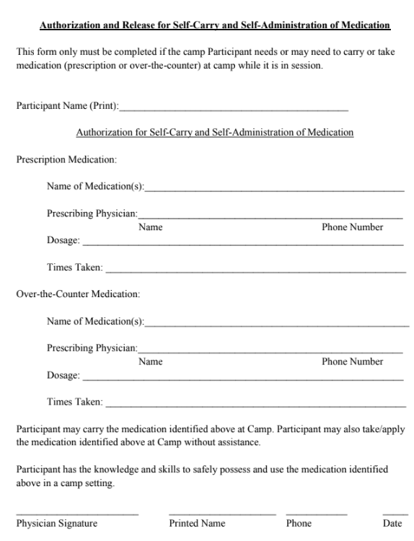
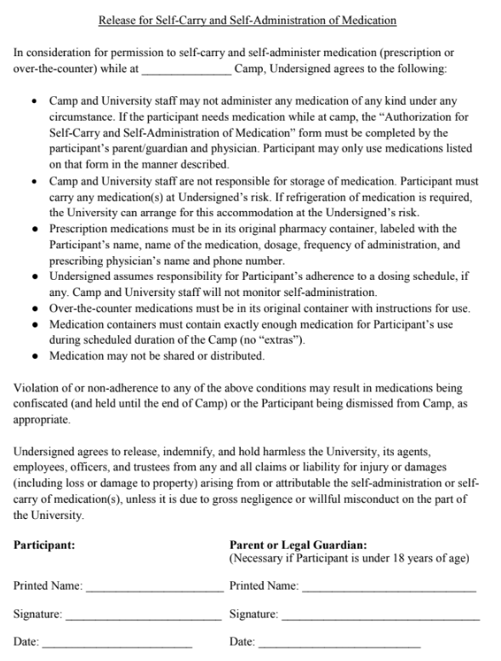

Slide 18
Summary
1. Emergency Preparedness
Emergency Response-DPS
Evacuation Emergency
Shelter-in-Place Emergency
Injury Illness Reporting
Employees
Non-Employees
2. Pre-employment Screening
3. Protecting Minors from Sexual Misconduct Training
4. Medical Care
5. Camper Medications

Slide 19
Questions?
cua-ehs@cua.edu

